Slide 1
Automatic Network Slicing Management for Transport Network
Author: Cristina Qiang
Email: qiangli3@huawei.com
Date: Mar. 27th, 2017

Slide 2
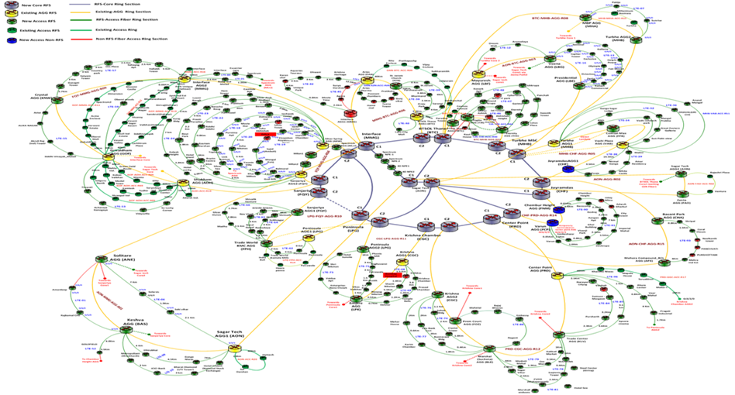
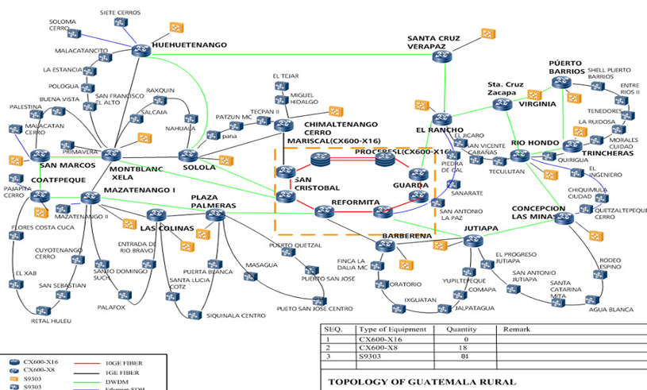
Motivation
Current Situation: complicated network topology
Tenants’ Requirement: Limited Time-to-Market
Operators’ Requirement: optimal resource allocation
Applications’ Requirement: flexible adjustment on demand

Slide 3

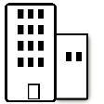





Vertical/Horizontal Architecture?
Tenants
Information/Topology model; Service Level Agreement (SLA) description…
Business Support System
Main Functions of TN Domain Manager:
Automatic composition/ de-composition/
optimization for NSIs
E2E Network Slicing Manager
Automatic self-monitoring/optimization inside each NSI
AN Domain Manager
TN Domain Manager
CN Domain Manager
Terminals
Automatic coordination with other domains
Underlying Resources
AP/BS
cache
Edge DC
Core DC
Terminal
Access Network (1..n)
Transmission Network (1..n)
Core Network (1..n)
Application

Slide 4
Automatic Composition (Mode I: Complete Logical Topology Requirement)
Input: NSI1 Logical Topology
NSI1_NodeList：A,B,C,D,E,F
NSI1_EdgeNodeList：A,B,F
Input: NSI2’s requirement
Input: NSI3’s requirement
C
A
F
NSI1_VLinkInfor：AC bandwidth 2M,
latency 1ms
CF bandwidth 4M，
latency 0.2 ms
B
D
E
TN-Domain Manager
Output： Configuration on Underlying Network for NSI1
Node A → physical device b VLink AB → physical link<a,c>
Port number on b: 12 bandwidth on <a,c>: 2M
Node B → physical device c VLink BD → physical link<c,e>
Port number on c: 4 bandwidth on <a,c>: 10M
b
d
g
A
C
i
C
a
F
A
F
e
h
j
D
E
c
D
B
B
f
E

Slide 5
Automatic Composition (Mode II: Vital Information of Logical Topology)
Input: NSI1 Vital Information
A
C
NSI1_EdgeNodeList：A,B,C
Input: NSI2’s requirement
Input: NSI3’s requirement
NSI1_VLinkInfo：A↔B 10M, 2ms
A↔ C 4M, 4ms
B↔C 8M, 6ms
B
TN-Domain Manager
Output： Configuration on Underlying Network for NSI1
g
b
d
Node A → physical device b
Node B → physical device c
Node C → physical device i
VLink AB → physical link <b,c>
A
i
a
C
A
C
e
h
j
B
c
B
f

Slide 6
Automatic Composition (Mode III: Service Requirement)
Input：Service Requirement
(Number_Entry, Number_Exit): (2,2)
exit1
Uplink_Entry1: 10 M Downlink_Entry1:20M
Input: NSI2’s requirement
Input: NSI3’s requirement
entry1
TN
Uplink_Entry2: 4M Downklink_Entry2: 8M
entry2
exit2
Uplink_Exit1: 10M Downlink_Exit1:40M
UNI Interfaces, Uplink, Downlink Infor
TN-Domain Manager
Output：Configuration on Underlying Network for NSI1
d
g
b
i
No node infor
UNI Interfaces
Full Mesh Topology
entry1
A
exit1
a
C
e
h
j
c
B
f
exit2
entry2

Slide 7
Conclusion
Discussed:
Motivation of automatic NS management
Main functions of TN domain manager
Automatic composition of TN topology
Future Work:
Automatic adjustment on demand
Automatic coordination with other domains
Design the protocol on north side

Slide 8
Q&A

